Slide 1

Revolutionizing Agriculture: Predictive Analytics for Crop Resilience Empowering Farmers to Prevent Crop Failure and Boost Yields

Slide 2
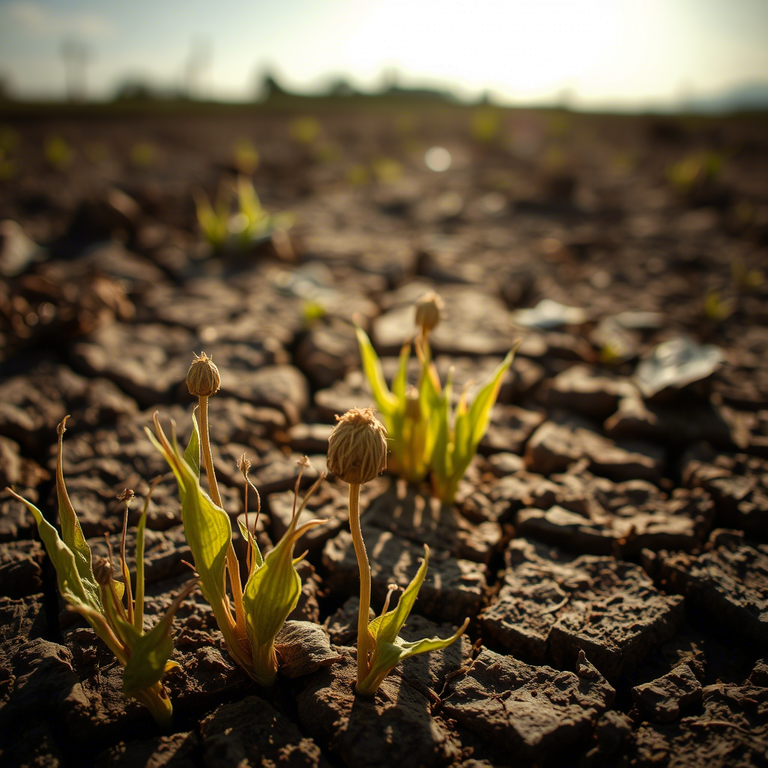
The Problem: The High Cost of Crop Failure
The Silent Threat: Crop Failure's Devastating Impact
Key Points:
Billions in economic losses annually due to unpredictable crop failures.
Significant contributor to food insecurity and supply chain disruptions.
Farmer livelihoods are jeopardized by unforeseen environmental stressors.
Current methods for identifying and mitigating issues are often reactive, leading to irreparable damage.

Slide 3

Our Solution: AI-Powered Crop Failure Prediction Proactive Protection: Our Predictive Analytics Platform Key Points: Leveraging machine learning to forecast crop failure risk before it occurs.
Analyzing crucial environmental factors: rainfall, pH, humidity, nitrogen (N), phosphorus (P), potassium (K), and temperature.
Enabling timely, data-driven interventions for farmers to mitigate risks.
Our Goal: Minimize losses, maximize yields, and contribute to global food security.

Slide 4
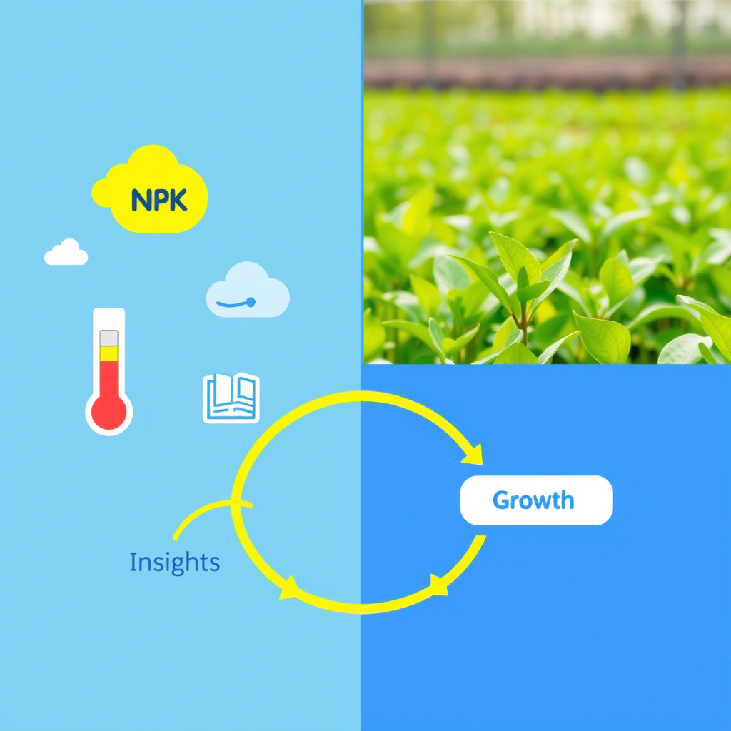
: Intelligent Insights: From Raw Data to Actionable Decisions Key Points: We utilize comprehensive agricultural datasets, including: N, P, K, temperature, humidity, pH, and rainfall. Our innovative approach includes simulating crop failure by defining critical thresholds (e.g., rainfall < 60, pH < 5.5, humidity < 45), creating a precise binary label for our prediction model. All features are standardized using StandardScaler to ensure optimal model performance and fair contribution of each variable. The data is meticulously split into training and testing sets to validate our model's effectiveness.
How It Works: The Data & The Model Foundation

Slide 5
The Challenge & Our Breakthrough: Overcoming Overfitting of the model
Headline: From Complexity to Clarity: Our Model Evolution
Key Points:
Initial Approach: We began with a Random Forest Classifier, a powerful ensemble method known for its high accuracy.
The Discovery: While Random Forest showed very strong performance on the training data, rigorous evaluation revealed signs of overfitting. This meant the model was memorizing the training data too well, potentially leading to unreliable predictions on new, unseen farm conditions.
Our Strategic Pivot: To ensure robust, real-world applicability, we made a crucial decision to transition to Logistic Regression. It has really brought our model to a more realistic model.

Slide 6

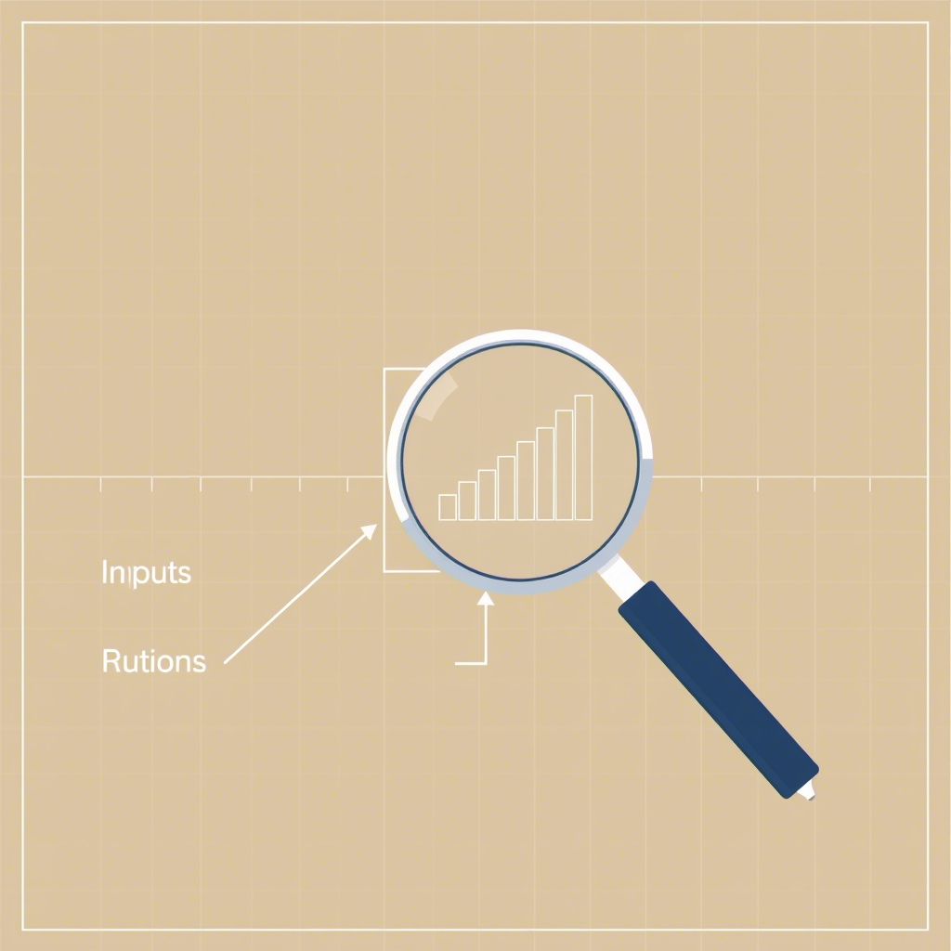
Selecting visual aids
Why Logistic Regression? A Robust & Interpretable Choice:
Precision and Reliability: The Power of Logistic Regression
Key Points:
Enhanced Interpretability: Logistic Regression provides clear insights into the individual impact of each environmental factor on crop failure risk, making the predictions actionable for farmers.
Reduced Overfitting Risk: Inherently less prone to overfitting than more complex models, especially when appropriately regularized and tuned.
Proven Generalization: Our rigorous cross-validation and testing confirm its consistent and reliable performance on diverse, unseen data.
Consistent Cross-Validation: An average 5-fold cross-validation F1-score of 0.84 across various data subsets demonstrates the model's stability and reliability.
ENHANCING YOUR PRESENTATION

Slide 7
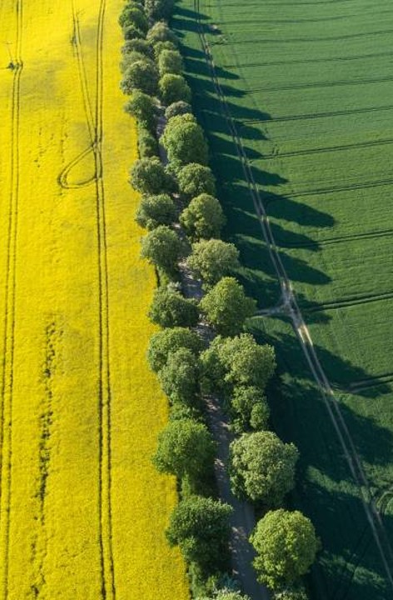
Our Model's Performance: Unpacking the Metrics
Headline: Delivering on Precision: Key Performance Indicators
Key Metrics (Tuned Logistic Regression on Test Data):
Accuracy: 0.87
Precision: 0.80
Recall: 0.83
F1-Score: 0.81
Validation of Generalization (Training vs. Test Data):
The minimal gap between training (F1-score: 0.85) and test performance (F1-score: 0.81) indicates our model has effectively learned the underlying patterns without memorizing noise.
This confirms that overfitting has been successfully resolved through our model selection and tuning process.

Slide 8
Addressing Overfitting: Our Tuning Strategy Headline: Fine-Tuning for Real-World Reliability
Key Points:
Regularization: We applied L2 regularization (controlled by the C parameter) to the Logistic Regression model, penalizing overly complex models and preventing overfitting.
Hyperparameter Tuning (Grid Search Cross-Validation): We systematically searched for the optimal C value across a defined range ([0.001, 0.01, 0.1, 1, 10, 100]), optimizing for the F1-score using 5-fold cross-validation.
Optimal Result: The Grid Search identified C=10 as the best parameter, yielding a strong average cross-validation F1-score of 0.84. This optimized model is now robust and ready for real-world application.

Slide 9

Empowering Farmers, Securing Futures
Headline: Real-World Benefits: A Sustainable Future for Agriculture
Key Points:
Proactive Intervention: Farmers receive early warnings, enabling them to implement preventive measures (e.g., precise irrigation, nutrient adjustments, disease control) before significant crop damage occurs.
Reduced Economic Losses: Substantial savings from prevented crop failures, directly boosting farmer profitability.
Optimized Resource Allocation: More efficient use of precious resources like water, fertilizers, and pesticides, leading to cost savings and environmental benefits.
Increased Yields & Food Security: Contributing to a more stable, predictable, and abundant food supply for communities worldwide.
Sustainable Farming Practices: Promoting data-driven, intelligent agriculture that minimizes waste and maximizes efficiency.

Slide 10

Our Vision: Scaling Impact
Headline: Cultivating a Resilient Agricultural Ecosystem
Key Points:
Expand Data Sources: Integrate real-time weather APIs, satellite imagery, and advanced soil sensor data for even more granular predictions.
Develop User-Friendly Platform: Create an intuitive web and mobile application for seamless monitoring, alerts, and actionable recommendations.
Strategic Partnerships: Collaborate with agricultural organizations, government bodies, and technology providers to scale adoption.
Global Expansion: Roll out our solution to support farming communities across diverse climates and agricultural landscapes worldwide.

Slide 11
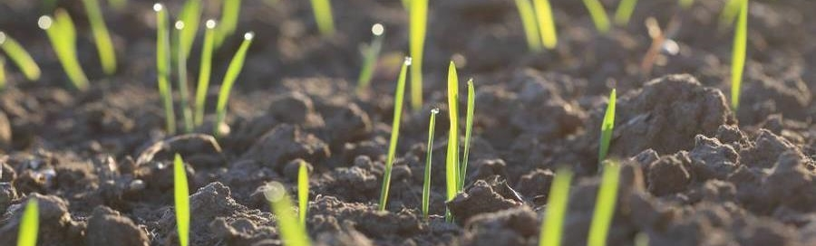
Call to Action Join Us in Cultivating a Smarter Future
Contact Information:
[GROUP 90 AI_SE]
KlaasMatlou[tshupianematlou@gmail.com]+27720724950
AlbertSipoi[albsipoi1564@gmail.com]+254706653253
TonnyOwong[TonnyOwonga@gmail.com]+254799374150
Ikechukwu[ikechukwulivingspring22@gmail.com]+2347047504914
We are actively seeking [Investment / Strategic Partnerships / Pilot Program Participants].
Help us empower farmers and build a more resilient global food system.
Contact us for a live demonstration and an in-depth discussion on how we can grow together.

Slide 12

Thank You Thank You

